Slide 1

Competitive Programming From Problem 2 Solution in O(1)
P
T
H
I
N
K
F
A
S
T
S
Compilation using Command Line
Mostafa Saad Ibrahim
PhD Student @ Simon Fraser University

Slide 2
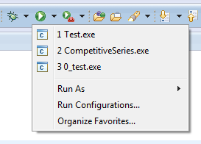
IDE compilation
So far we used to just click on run in IDE
Then we just get things compiled for us
As we said, actual process is multi steps
Two major ones
Code Compilation
Object Files Linking

Slide 3
IDE behind the scene?
Remember, we setuped some compiler
gcc is GNU C Compiler
g++ is GNU C++ Compiler
E.g. 4.9 version supports C++11
And others (e.g. Visual studio Compiler)
Each compile has many commands option
You can call the compiler from the command line (CLI)
Pass some input files + processing parameters

Slide 4

Compiling from command line
g++ is the GNU c++ compiler name..it has several prameters (-something)
-c => we need object files
-o => The name of object file
Last parameter is the file name

Slide 5
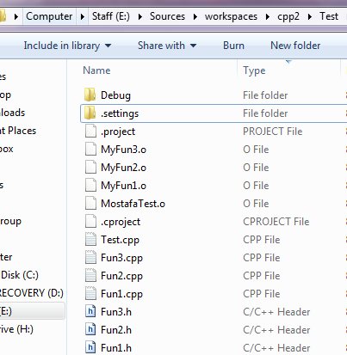
Compiler generated files

Slide 6

Linking & Running
Notice, we give it all the object files to combine them for us

Slide 7
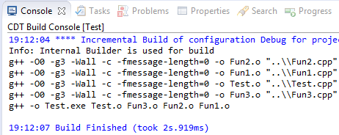
Eclipse Compile / Link for you

Slide 8
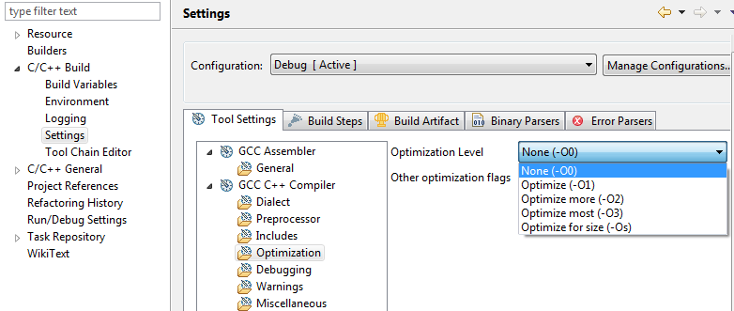
Optimization Parameter

Slide 9
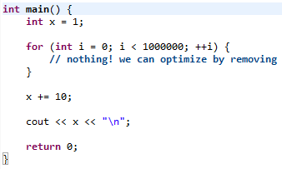
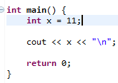
Optimizing?

Slide 10
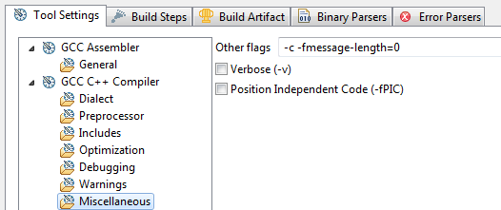
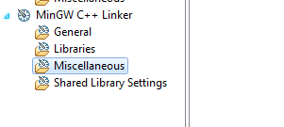
More compile/link options

Slide 11
Home Work
Learn more of the paramaters of g++ (or VS)
Make a meduim dummy project
Compile it ... Link it
Play around it
Try to remove main function and link
Try to remove a header defintion used
Try to link a missing object file
Explore/Search Eclipse Setting tab content

Slide 12
تم بحمد الله
علمكم الله ما ينفعكم
ونفعكم بما تعلمتم
وزادكم علماً

